Slide 1


Lecture 2 Review
DATA STRUCTURE
AND ALGORITHMS
(CS 201)
2
Fall (2025-2026)

Slide 2
Course Learning Objectives
Implement and manipulate linear data structures such as arrays and linked lists, performing fundamental operations including insertion, deletion, and traversal.
Apply and implement special linear data structures such as stacks and queues, utilizing their core operations (push, pop, enqueue, and dequeue).
Design and implement basic sorting algorithms to organize data efficiently.
Apply searching algorithms, including sequential search, binary search, and hashing techniques.
Implement and manipulate non-linear data structures, particularly binary trees and binary search trees, performing key operations such as insertion, deletion, and traversal.
Utilize graph data structures and apply fundamental graph algorithms for problem-solving.
Demonstrate effective teamwork skills by collaborating within groups to develop algorithmic solutions.

Slide 3
Functions

Slide 4
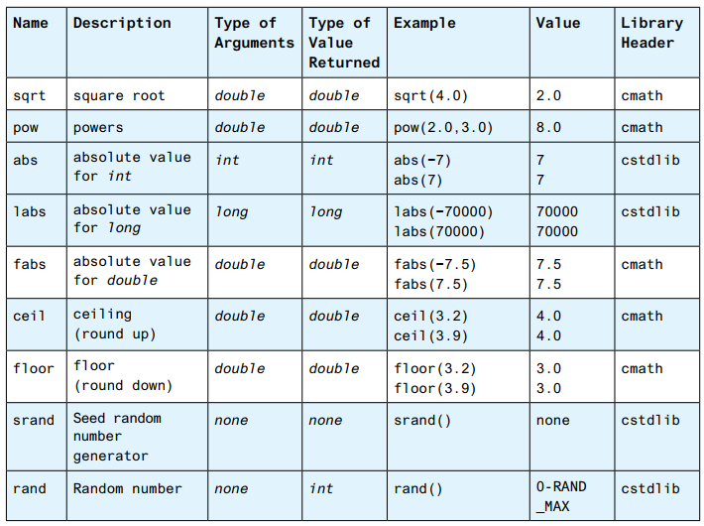

Predefined Functions
C++ comes with libraries of predefined functions that you can use in your programs.
Using #include to include a library, for example:
#include <cmath>
You can see more predefined functions.

Slide 5
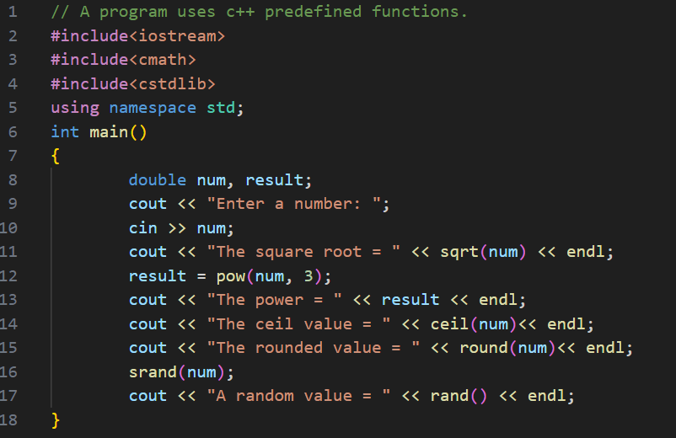
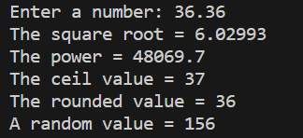
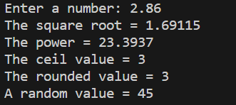
C++ Libraries

Slide 6
Programmer-defined Functions

Slide 7
Opening Problem
What does this program do?
int main()
{
int sum = 0;
for (int i = 1; i <= 10; i++)
sum += i;
cout << "Sum from 1 to 10 is " << sum << endl;
sum = 0;
for (int i = 20; i <= 37; i++)
sum += i;
cout << "Sum from 20 to 37 is " << sum << endl;
sum = 0;
for (int i = 35; i <= 49; i++)
sum += i;
cout << "Sum from 35 to 49 is " << sum << endl;
return 0;
}
Notes:
Find the sum of integers from 1 to 10, from 20 to 37, and from 35 to 49, respectively.

Slide 8
An Alternative
int sum(int i1, int i2)
{
int sum = 0;
for (int i = i1; i <= i2; i++)
sum += i;
return sum;
}
int main()
{
cout << "Sum from 1 to 10 is " << sum(1, 10) << endl;
cout << "Sum from 20 to 37 is " << sum(20, 37) << endl;
cout << "Sum from 35 to 49 is " << sum(35, 49) << endl;
return 0;
}
Function Definition
(Define a Function)
Function Call
(Invoke a function)

Slide 9
An Alternative
Return value type
Method name
int sum(int i1, int i2)
{
int sum = 0;
for (int i = i1; i <= i2; i++)
sum += i;
return sum;
}
int main()
{
cout << "Sum from 1 to 10 is " << sum(1, 10) << endl;
cout << "Sum from 20 to 37 is " << sum(20, 37) << endl;
cout << "Sum from 35 to 49 is " << sum(35, 49) << endl;
return 0;
}
Parameters List
Return value

Slide 10
An Alternative
Function signature
Function header
int sum(int i1, int i2)
{
int sum = 0;
for (int i = i1; i <= i2; i++)
sum += i;
return sum;
}
int main()
{
cout << "Sum from 1 to 10 is " << sum(1, 10) << endl;
cout << "Sum from 20 to 37 is " << sum(20, 37) << endl;
cout << "Sum from 35 to 49 is " << sum(35, 49) << endl;
return 0;
}
Function body

Slide 11
Overloading Functions
The max function used earlier works for int data type.
What if you also need the max of two floating-point numbers?

Slide 12
// Return the max of two int values
int max(int num1, int num2)
{
if (num1 > num2)
return num1;
else
return num2;
}
// Find the max of two double values
double max(double num1, double num2)
{
if (num1 > num2)
return num1;
else
return num2;
}
// Return the max of three double values
double max(double num1, double num2, double num3)
{
return max(max(num1, num2), num3);
}

Slide 13
int main()
{
// Invoke the max function with int parameters
cout << "The maximum of 3 and 4 is "
<< max(3, 4) << endl;
// Invoke the max function with the double parameters
cout << "The maximum of 3.0 and 5.4 is "
<< max(3.0, 5.4) << endl;
// Invoke the max function with three double parameters
cout << "The maximum of 3.0, 5.4, and 10.14 is "
<< max(3.0, 5.4, 10.14) << endl;
return 0;
}

Slide 14
Ambiguous Invocation
int maxNumber(int num1, double num2)
{
if (num1 > num2)
return num1;
else
return num2;
}
double maxNumber(double num1, int num2)
{
if (num1 > num2)
return num1;
else
return num2;
}
int main()
{
cout << maxNumber(1, 2) << endl;
return 0;
}
Ambiguous invocation is a compilation error.
Notes:
Ambiguous غامض

Slide 15
Header files
#include <iostream>
using namespace std;
// Function prototype
int max(int num1, int num2);
double max(double num1, double num2);
double max(double num1, double num2, double num3);
int main()
{
cout << "The maximum of 3 and 4 is " << max(3, 4) << endl;
cout << "The maximum of 3.0 and 5.4 is " << max(3.0, 5.4) << endl;
cout << "The maximum of 3.0, 5.4, and 10.14 is " << max(3.0, 5.4, 10.14) << endl;
return 0;
}
int max(int num1, int num2)
{
…
}
double max(double num1, double num2)
{
…
}
double max(double num1, double num2, double num3)
{
…
}
Can be moved to a separate header file. MyFile.h
Then add:
#include "MyFile.h"
Should be moved with the prototypes to MyFile.h
or to MyFile.cpp
Reusing Functions by Different Programs

Slide 16
#include <iostream>
#include "MyFile.h"
using namespace std;
int main()
{
cout << "The maximum of 3 and 4 is " << max(3, 4) << endl;
cout << "The maximum of 3.0 and 5.4 is " << max(3.0, 5.4) << endl;
cout << "The maximum of 3.0, 5.4, and 10.14 is " << max(3.0, 5.4, 10.14) << endl;
return 0;
}
Header files

Slide 17
Global Variables
Global variables:
Declared outside all functions and are accessible to all functions in its scope.
Defaulted to zero if not directly assigned.

Slide 18
Global Variables
#include <iostream>
using namespace std;
void t1(); // Fnc prototype
void t2(); // Fnc prototype
int main()
{
t1();
t2();
return 0;
}
int y;
void t1()
{
int x = 1;
cout << "x is " << x << endl << "y is " << y << endl;
x++; y++;
}
void t2()
{
int x = 1;
cout << "x is " << x << endl << "y is " << y << endl;
}
A)
x is 1
y is 0
x is 2
y is 1
B)
x is 1
y is 0
x is 2
y is 2
// Global variable, default to 0
C)
x is 1
y is 0
x is 1
y is 1
D)
x is 1
y is 0
x is 1
y is 2

Slide 19

Pass by Value
Write a program for swapping two variables.
void swap(int n1, int n2)
{
int temp = n1;
n1 = n2;
n2 = temp;
}
The values of the arguments are not changed after the function is invoked.
int main()
{
int num1 = 1;
int num2 = 2;
swap(num1, num2);
cout << "After invoking the swap function, num1 is "
<< num1 << " and num2 is " << num2 << endl;
return 0;
}
After invoking the swap function, num1 is 1 and num2 is 2

Slide 20
Pass by Reference
Write a program for swapping two variables.
void swap(int& n1, int& n2)
{
int temp = n1;
n1 = n2;
n2 = temp;
}
int main()
{
int num1 = 1;
int num2 = 2;
swap(num1, num2);
cout << "After invoking the swap function, num1 is "
<< num1 << " and num2 is " << num2 << endl;
return 0;
}
After invoking the swap function, num1 is 2 and num2 is 1
96

Slide 21
Reference Variables Example
int main()
{
int count = 1;
int& r = count;
cout << "count is " << count << endl;
cout << "r is " << r << endl;
r++;
cout << "count is " << count << endl;
cout << "r is " << r << endl;
count = 10;
cout << "count is " << count << endl;
cout << "r is " << r << endl;
return 0;
}
count is 1
r is 1
count is 2
r is 2
count is 10
r is 10

Slide 22
Combining Data into Structures
Structure: C++ construct that allows multiple variables to be grouped together.
General Format:
struct structName
{
type1 field1; type2 field2;
. . .
struct Student
{
int studentID;
string name; short intake; double gpa;
};
};

Slide 23
Example struct Declaration
struct Student
{
int studentID;
string name;
short intake;
double gpa;
};
structure tag
structure members
int main()
{
Student adham; Student esraa;
⋮
}

Slide 24

Defining struct Variables
struct declaration does not allocate memory or create variables
To define variables, use structure tag as type name:
Student hesham;
hesham
studentID
name intake
gpa

Slide 25
Accessing struct Members
Use the dot (.) operator to refer to members of struct variables:
struct Student
{
int studentID; string name; short intake; double gpa;
};
Student stu1;
cin >> stu1.studentID; stu1.gpa = 3.75;
Member variables can be used in any manner appropriate for their data type.

Slide 26

Displaying a struct Variable
Student kareem; cout << kareem;
struct Student
{
int studentID; string name; short intake; double gpa;
};
// won’t work
cout << kareem.studentID <<endl; cout << kareem.name << endl;
cout << kareem.intake << endl; cout << kareem.gpa << endl;

Slide 27

Copying struct Variables
Student kareem;
Student studentRepresentative;
struct Student
{
int studentID; string name; short intake; double gpa;
};
studentRepresentative = kareem;

Slide 28

Comparing struct Variables
if (studentRepresentative == kareem) // won’t work
if (studentRepresentative.studentID == kareem.studentID)
struct Student
{
int studentID; string name; short intake; double gpa;
};

Slide 29



